Slide 1


INTRODUCTION TO
MUTUAL FUND
  Mr. M.I. MOHAMED IBRAHIM
  M.Com., M.Phil., M.B.A., SET (Com)., SET (Mgt).,
  Assistant Professor
  PG & Research Department of Commerce (SF-Men)
  JAMAL MOHAMED COLLEGE (Autonomous)
  Tiruchirappalli – 20.

Slide 2

CONTENTS:
MUTUAL FUND - MEANING
TYPES
FUNCTIONS
ADVANTAGES/BENEFITS
FACILITIES
SELECTION
SEBI – GUIDELJINES
MERCHANT BANKING - MEANING
TYPES
SCOPE IN INDIA

Slide 3

MEANING:
A mutual fund is a pool of money managed by a professional Fund Manager. It is a trust that collects money from a number of investors who share a common investment objective and invests the same in equities, bonds, money market instruments and/or other securities.

Slide 4

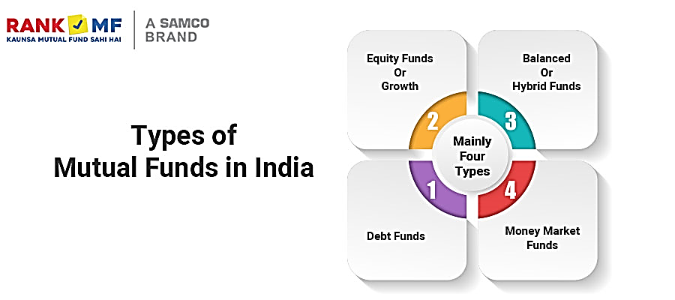

Slide 5

FUNCTIONS

Slide 6



Slide 7


FACILITIES

Slide 8

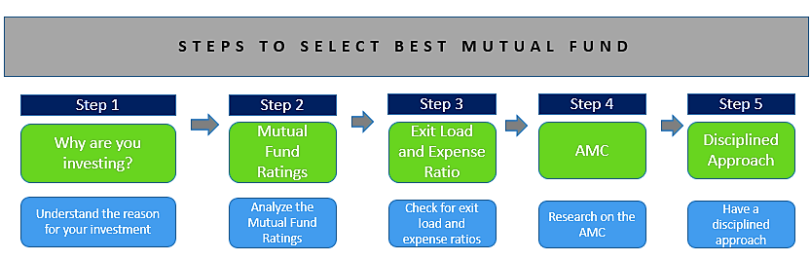
SELECTION

Slide 9


Slide 10
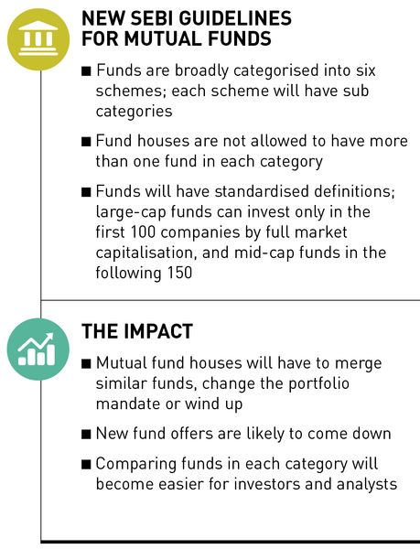


Slide 11



Slide 12
Merchant Banking
Meaning:
The term merchant banking is used differently in different countries and so there is no precise definition for it. In London merchant banker refers to those who are members of British Merchant Banking and Securities House Association who carry on consultation, leasing, portfolio services, assets management, euro credits, loan syndication, etc. In America, merchant banking is concerned with mobilizing savings of people and directing the funds to business enterprise.

Slide 13
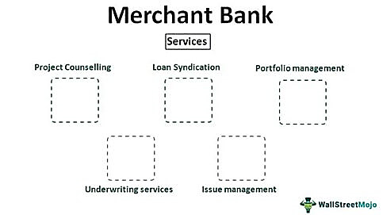
TYPES

Slide 14
Scope for Merchant Banks in India
The present capital market scenario provides a vast scope for merchant banking in India. Below mentioned point justify it clearly.
Growth of new issue market – Due to unprecedented growth in new issue market. MB’s has to play crucial role in managing issue of shares & securities.
Entry of foreign investors – has further improved their scope in India due to opening up Indian Capital market in 1992 for foreign investors. Increasing number of joint ventures abroad by Indian companies and further increased this scope.

Slide 15

  Mr. M. I. MOHAMED IBRAHIM
  Mail ID: mi@jmc.edu

